Slide 1
Final Presentation
Sedge, Jino, Charlene, Jeffrey

Slide 2
Project Overview
Objective: Facilitate student organizations in discovering available UCLA activities, to open up opportunities for group collaboration and togetherness while also encouraging community engagement out of our campus, particularly by providing easy access to steps for planning such activities for club socials/events.
Offering assistance in planning in the following:
Transportation (not limited to)
Providing bus routes, van/bike rental information, carpool planning tools, and car parking structures/lots
Booking: Reservations and rental checkouts
Providing specific activity information and details
Price, location, required equipment skill level
Priorities to minimize the cognitive load for student leaders in planning these events and to extend the visibility and reach of the expansive network of local recreational activities.

Slide 3

1
Background Research

Slide 4

Literature Topics
Effects of Social Activities on College Students
Nature/community engagement effects on wellness
Barriers and motivations to student engagement of outdoor programs
Economics of student activities

Slide 5

Key Takeaways
The primary motivations for college students joining outdoor adventure programs is social factors and stimulus avoidance.
Barriers to recreational programs are often multifaceted.
Engaging with nature can lower stress, restore attention, and numerous other benefits for students.
Socialization is an important component in students’ cognitive development.
Engaging in well structured club activities improves academic performance.
Personal perceptions of difficulty or time commitment are serious barriers for student exercise.

Slide 6
Formative Interviews
1
2
Club
Organizers
Students Club Members
We completed 3 individual interviews with potential stakeholders to understand their needs and pain points. 2 interviews will talk with UCLA students on their current recreation and community engagement practices while the third will speak with a club board member about how they organize their club events and socials.

Slide 7
Sample Questions
Club Organizer Script:
Describe any events/socials the club has hosted/organized.
What is the process for planning them?
How do students typically get to these socials/events? Is transportation a common issue?
What are the primary barriers/difficulties when planning a club event/social?
Student Script:
What, if any, recreational/community engagement programs have you been a part of at/through UCLA?
Have any clubs/student organizations you've been a part of organized group recreational events?
What are your top 3 motivating factors to engage with UCLA's recreation/community engagement programs?

Slide 8
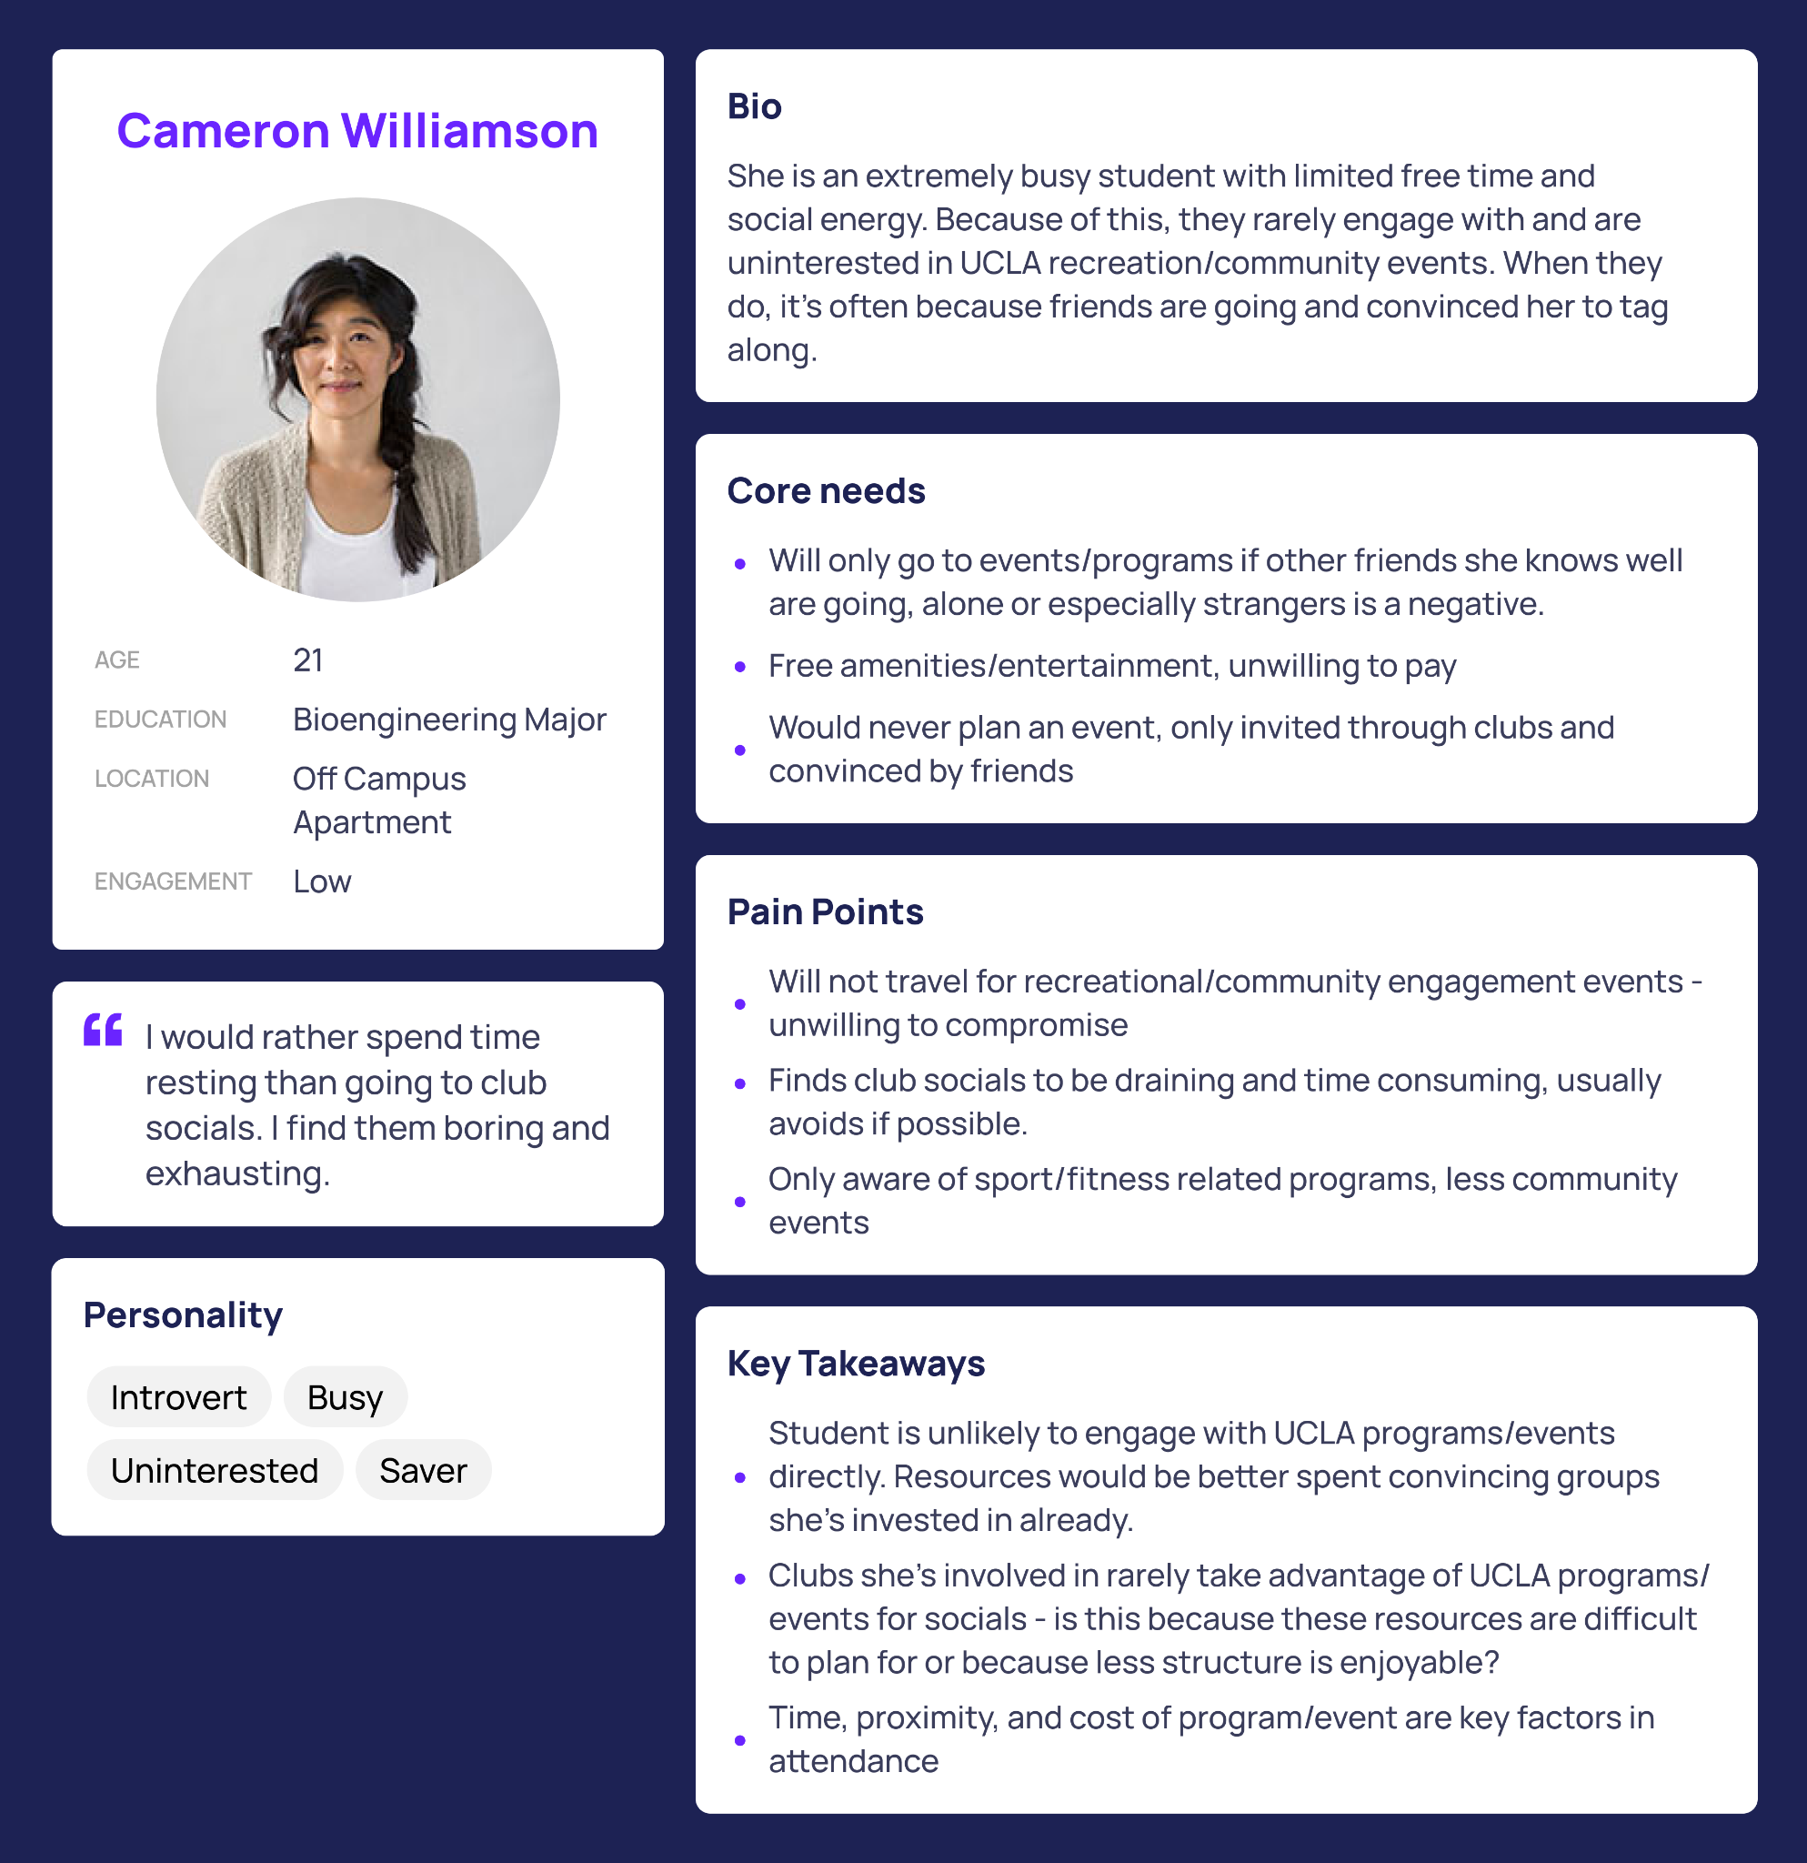
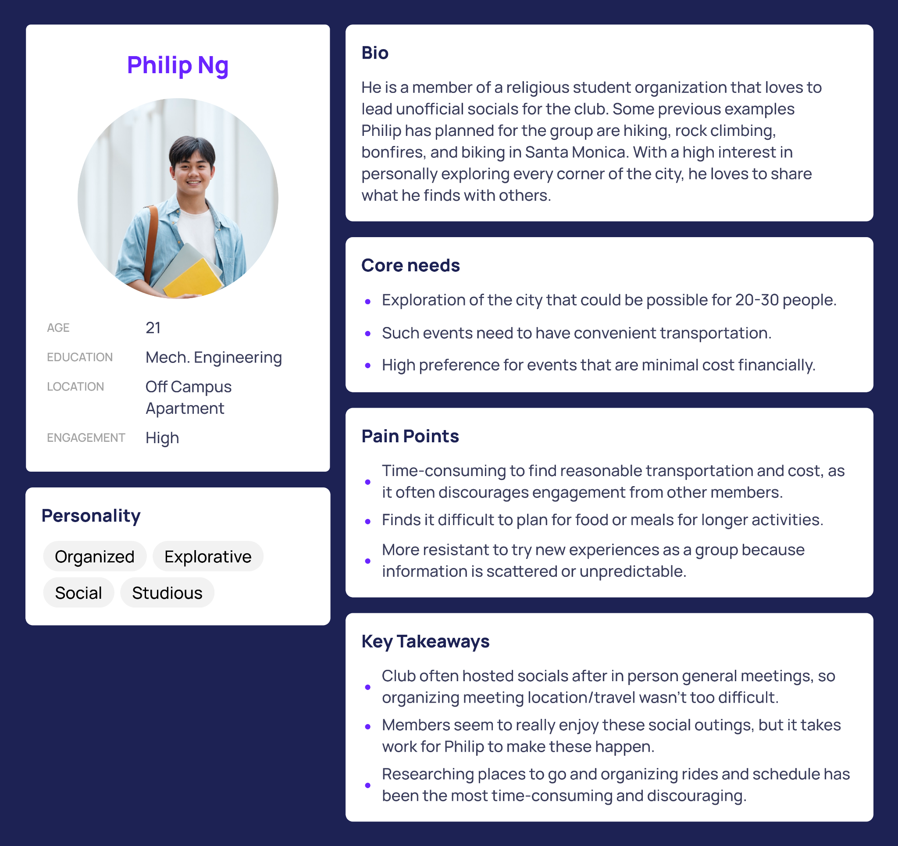
Individual Interviews

Slide 9
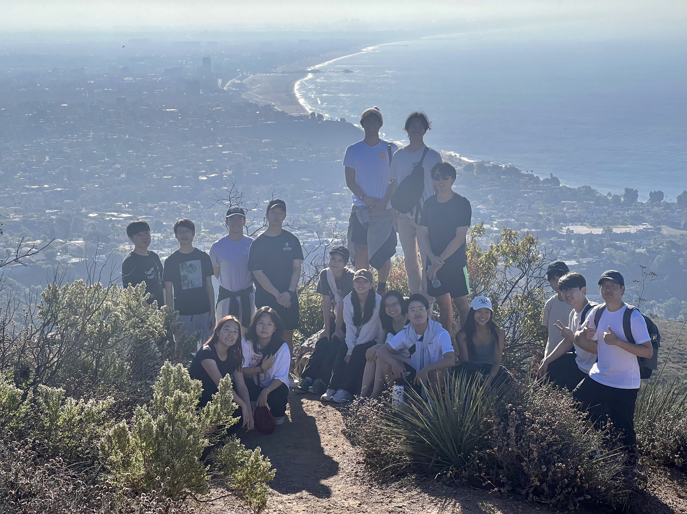
Ethnographic Research
The ethnographic research chosen to examine the stakeholders first hand was participating in a group hike at Los Leones hosted by a UCLA club that is not primarily associated with nature or community engagement.
The research included positive observations of group recreational engagement and understanding pain points experienced by student organizers who were planning the event.

Slide 10
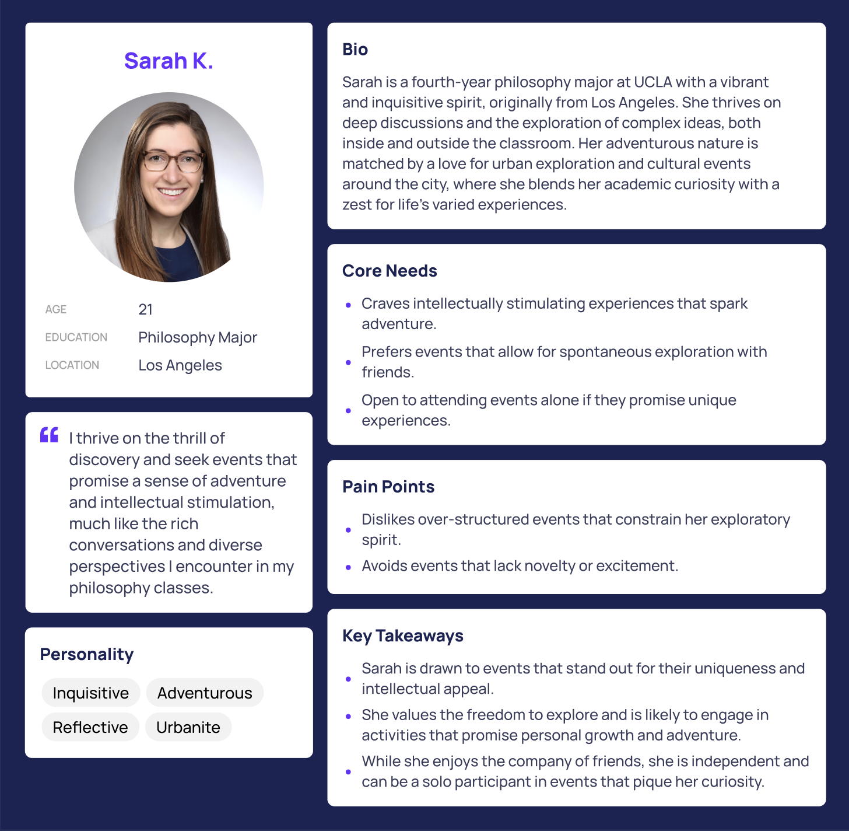
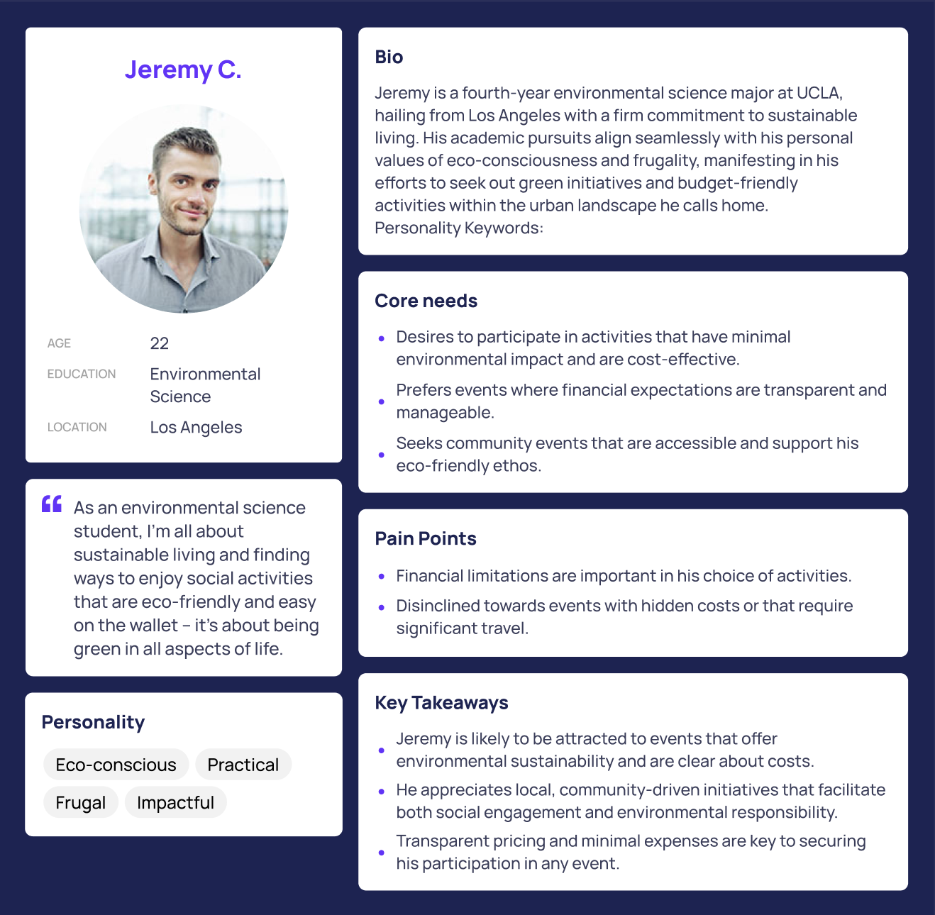
Focus Group Interviews

Slide 11
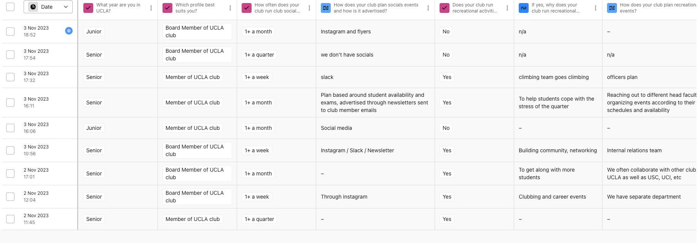
Survey
The survey portion of our user research allowed us to get a broader scope and understanding of the scene, as we were able to ask a wider range of students with much better time efficiency. The survey below incorporates both multiple choice and short-answer experience questions to evaluate the user’s experience with their student organization and to assess any needs they have currently.

Slide 12
Survey Insights
How does your club run socials?
Pain Points?
Why does your club run social events?
Mostly through social media(instagram, slack, group chat)
Club leaders are mostly responsible for designating activities and schedule.
Many of the internal club social events are scheduled last minute, which troubles the participation of many club members with schedule issues.
Bonding between club members.
Help students cope with stress of quarter.
Promote networking within and outside of the club.

Slide 13

2
Iterative Design

Slide 14

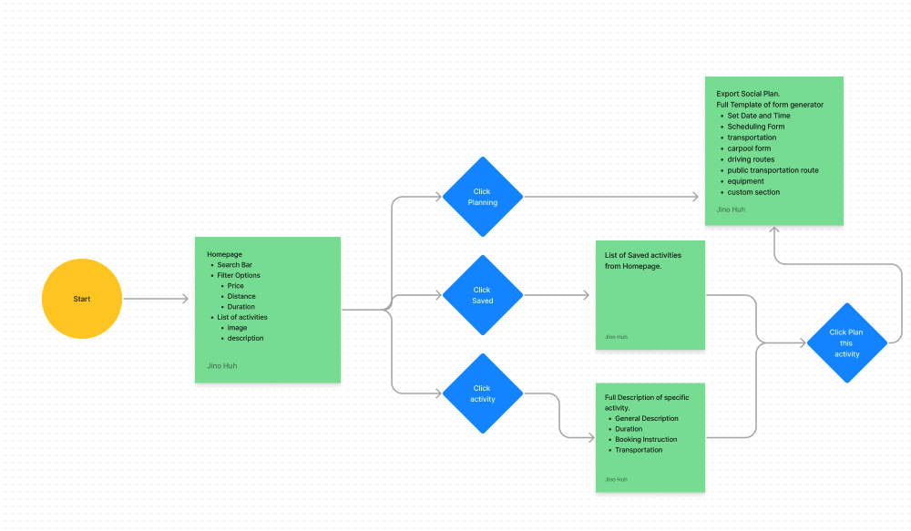
Design Architecture
Link to Figma

Slide 15
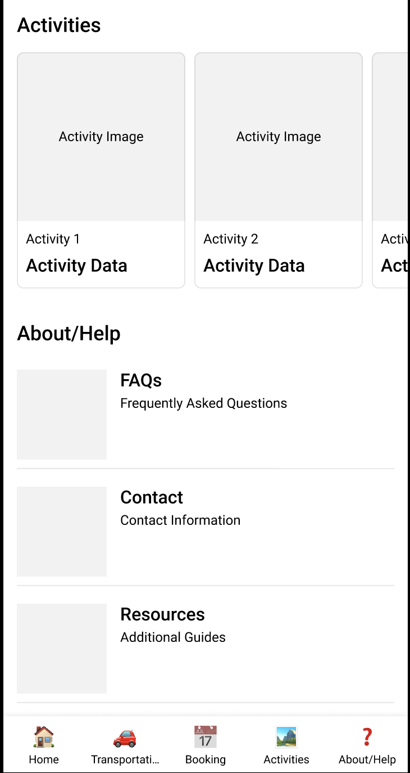
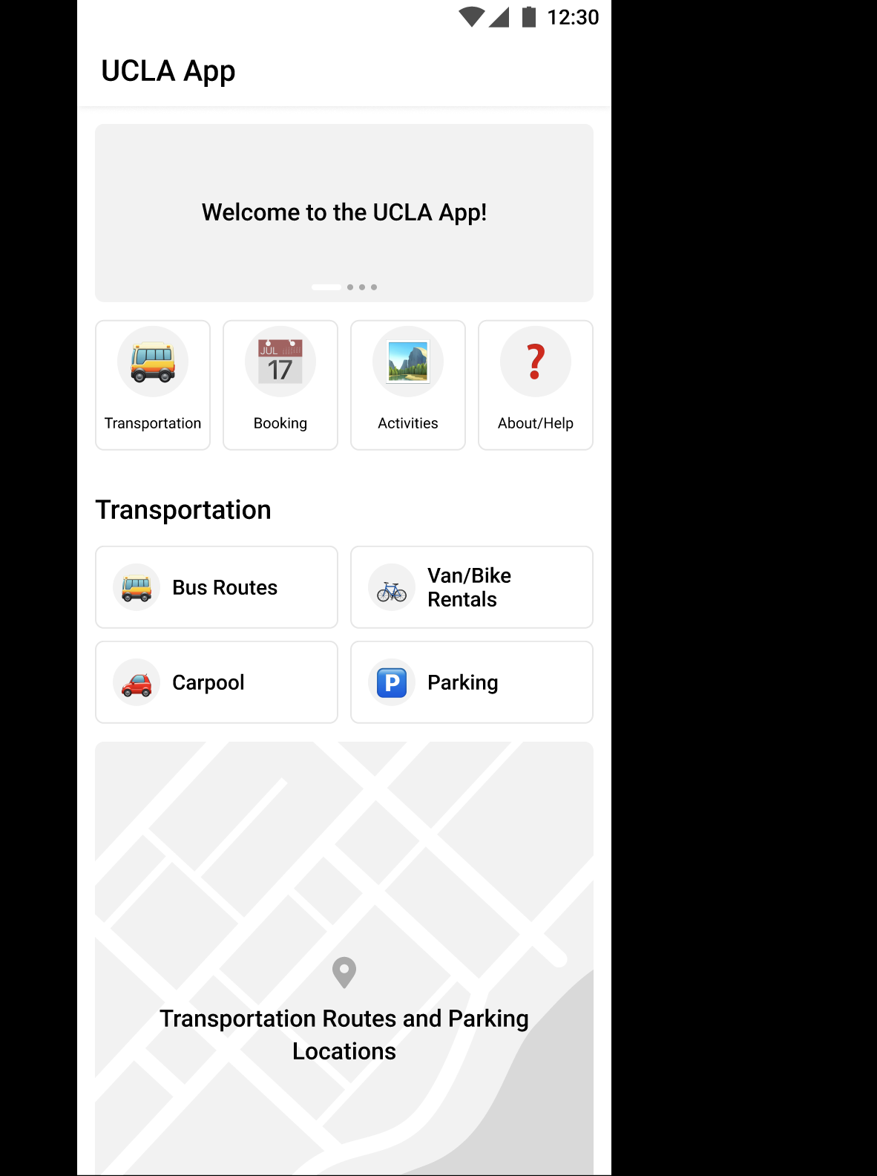
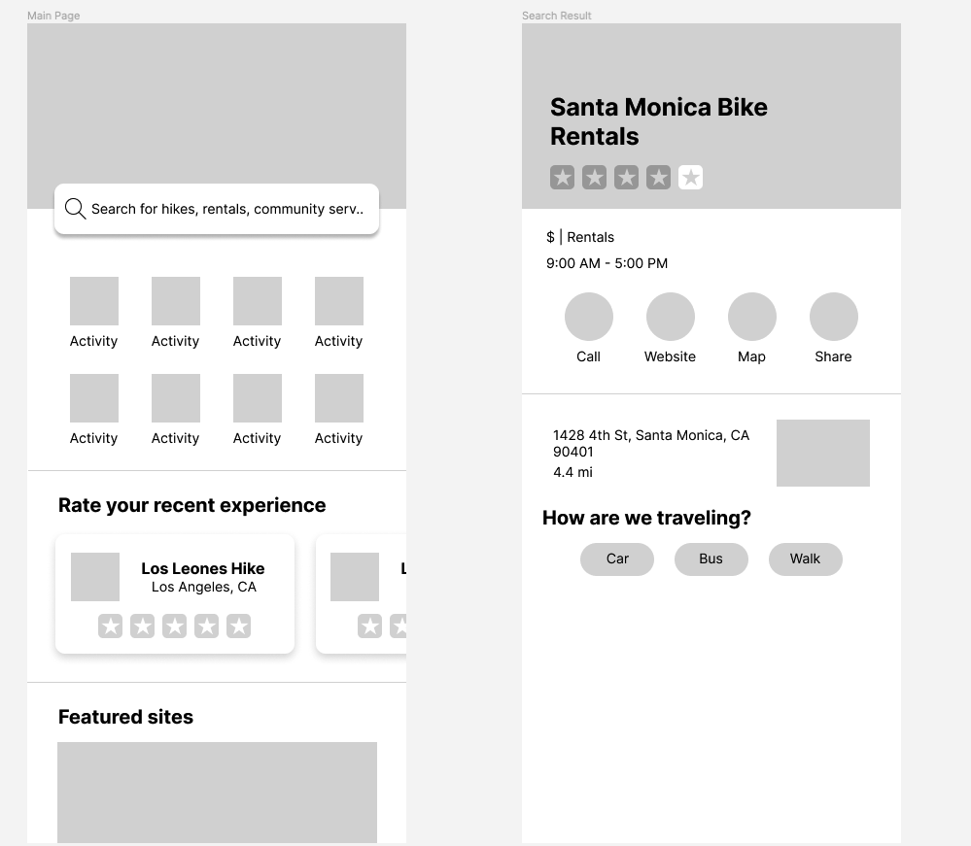
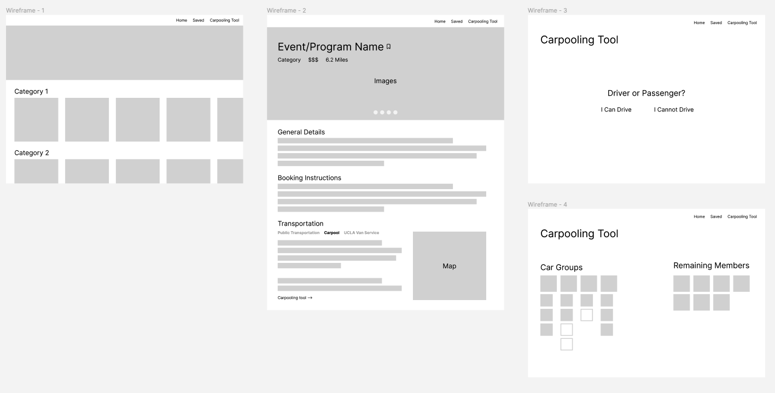
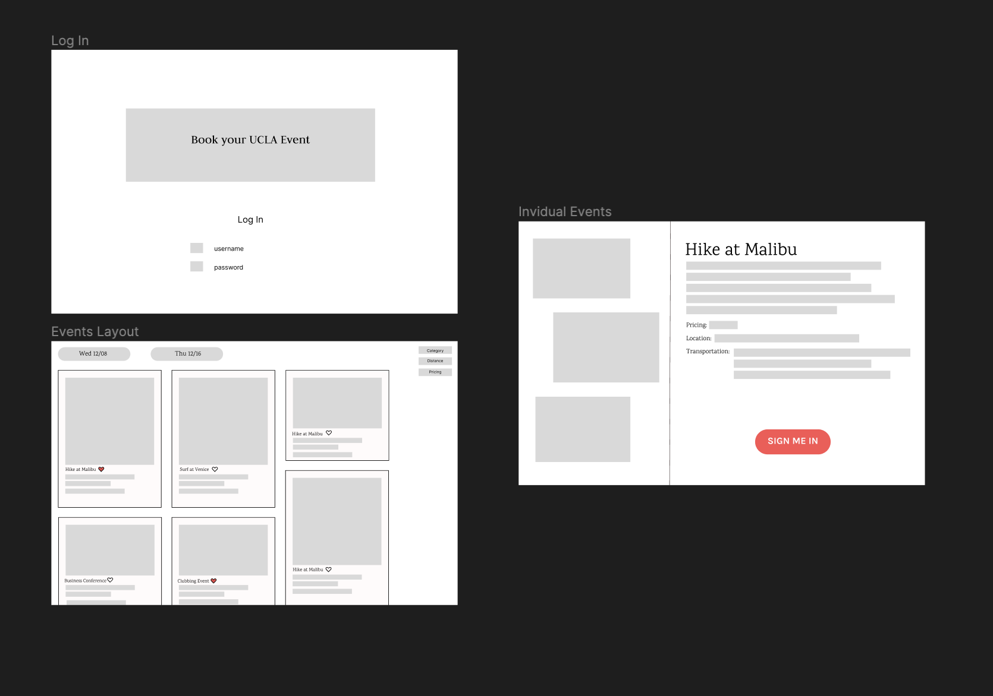
Individual Wire Frames
We began the design process by each creating our own lo-fi design concept based on our collective research insights. This gave us a diverse set of potential layouts and features that we then pulled together to create a cohesive lo-fi design.

Slide 16
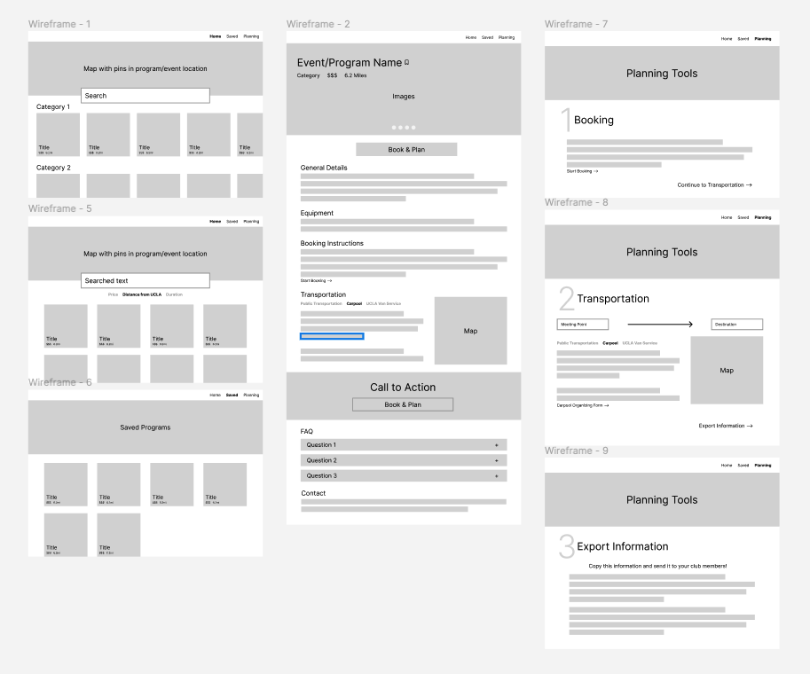
Final Wire Frame
Design Features
Categorical design of activities.
Listing of events by categories for users’ ease of navigating certain activities
Event Details
Once clicking on a specific event, give users access to booking instructions, transportation information etc.
Planning Tools
Once clicking on a specific event, give users access to booking instructions, transportation information etc.

Slide 17
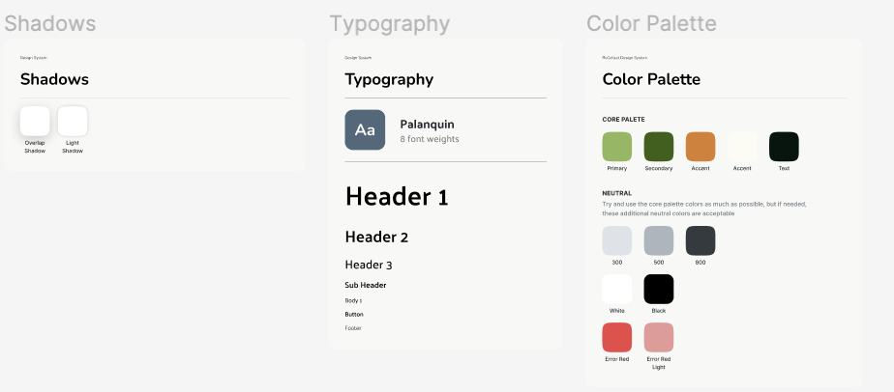
Style Guide
A small style guide covering the typography, color palette, and shading helped our team to convert our lo-fi design into hi-fi prototypes that would be consistent between team members.

Slide 18
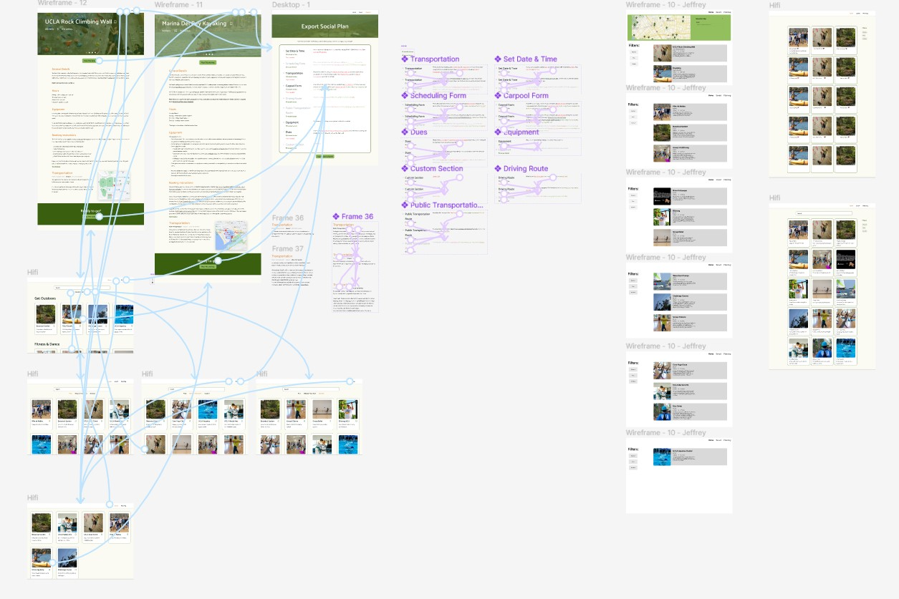
Hi-Fi Prototype
Utilizing the style guide, we converted our wireframe mockups into a high fidelity prototype. The completed prototype included 2 variations of the home screen, 2 activity details pages, a saved screen, and and a planning tool.
Between the low-fi wireframes and this high fidelity design, we decided to move away from a multipage planning tool into a single integrated screen where users could create a message containing event plans to send out to their club members by mixing and matching different templates and forms.
Link to Figma

Slide 19
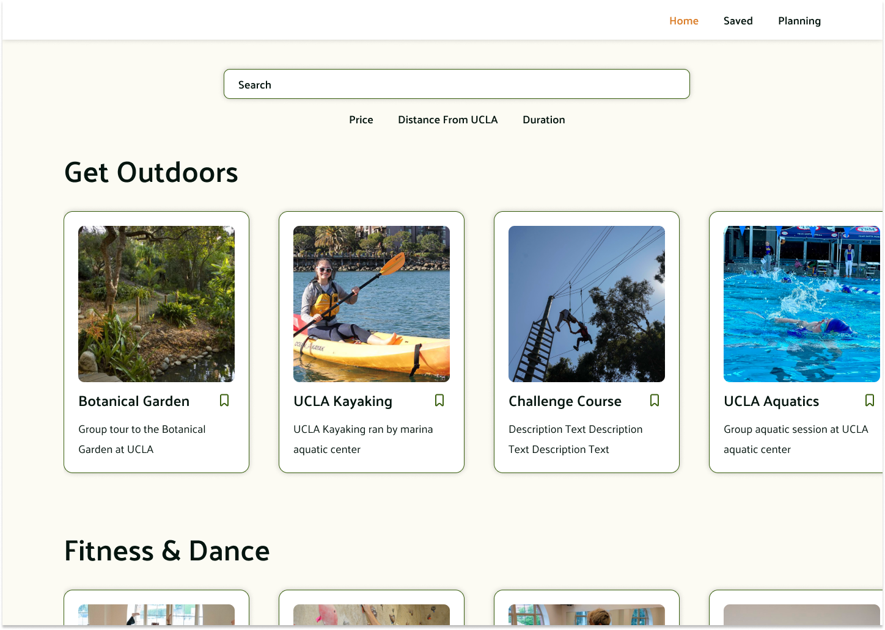
Home Page
1
2
Search bar
Filtering tools
Categorized activity cards
3

Slide 20
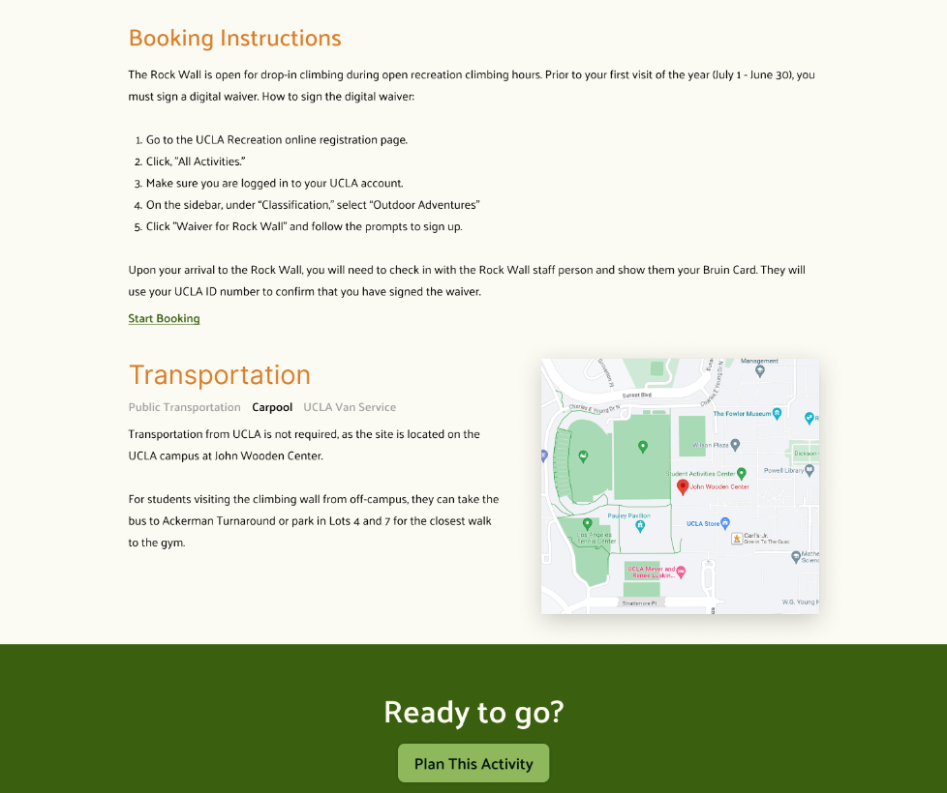
Activity
Information
1
Booking instructions
Logistical details
Links to the planning tool
2
3

Slide 21
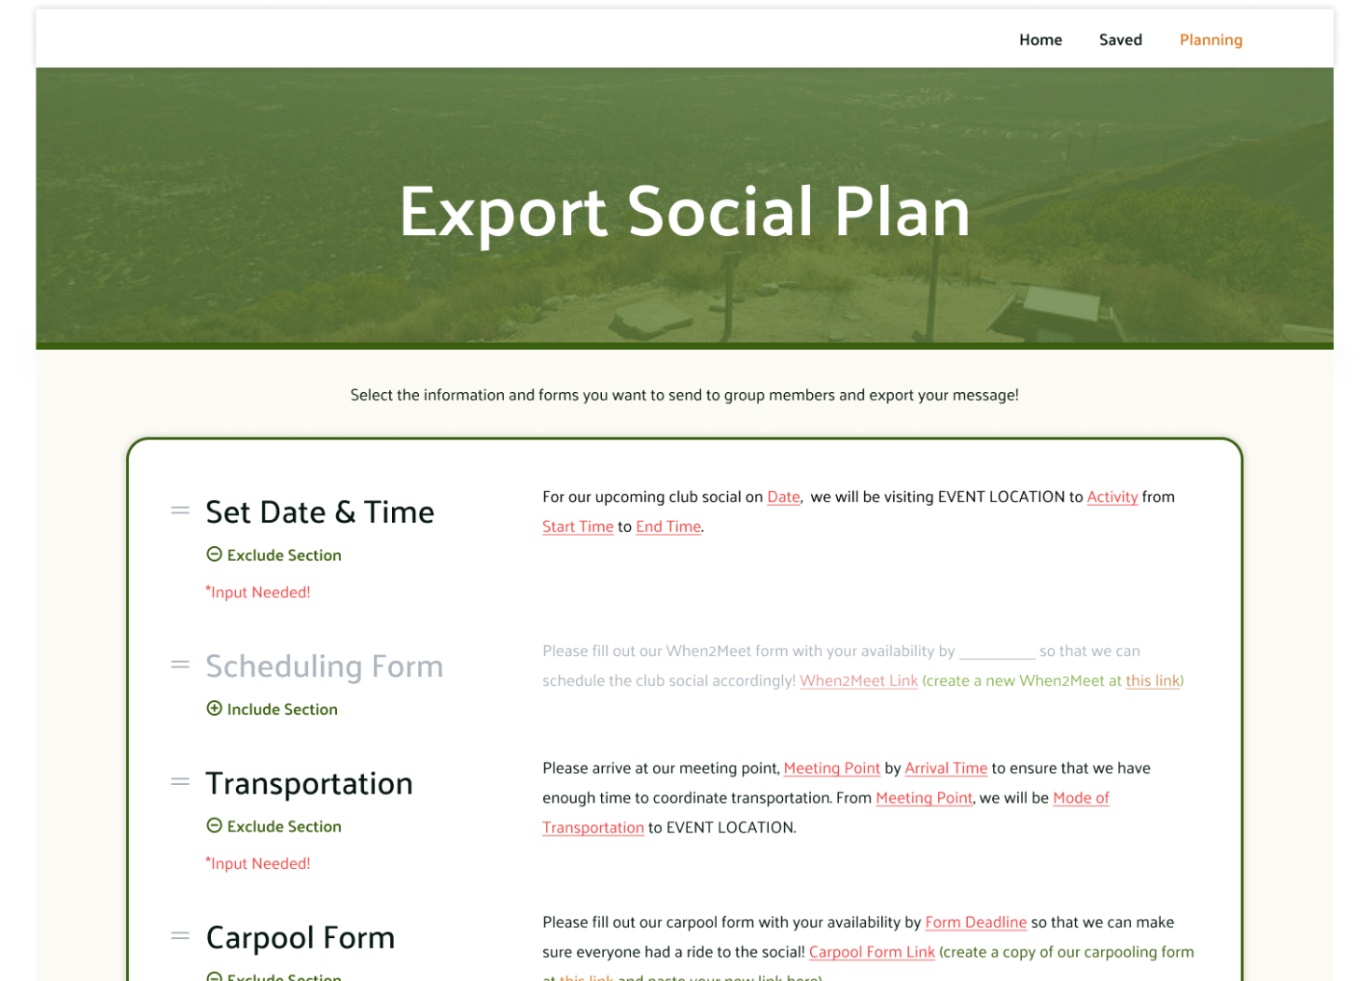
Planning Tool
Customizable message components
Predefined user templates
Links to external tools
1
2
3

Slide 22

3
Usability
Testing Report

Slide 23
Usability Test Techniques
Usability Test Objective: Engaging six UCLA participants in a simulated environment where they assume the role of club leaders, our study focused on evaluating their interactions with two distinct homepage layouts.
A/B Testing Approach: We implemented A/B testing to compare how participants interact with either a Pinterest-style layout or a detailed card layout, aiming to discern which design offers a more intuitive and efficient user experience.
Protocols: Follow the Usability Testing script to ask participants to complete the user tasks. Follow up the testing with the structured interview. Record interactions via video camera or voice recordings as agreed to by participant.
Scripts are pre-written for introduction, task completion, post-testing interview, and summary/recap questions.

Slide 24
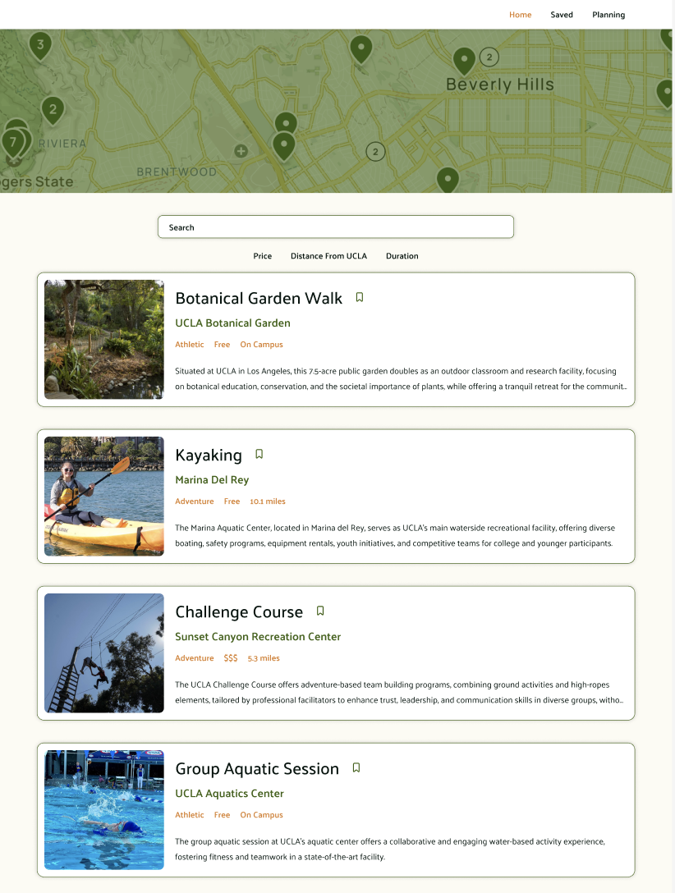
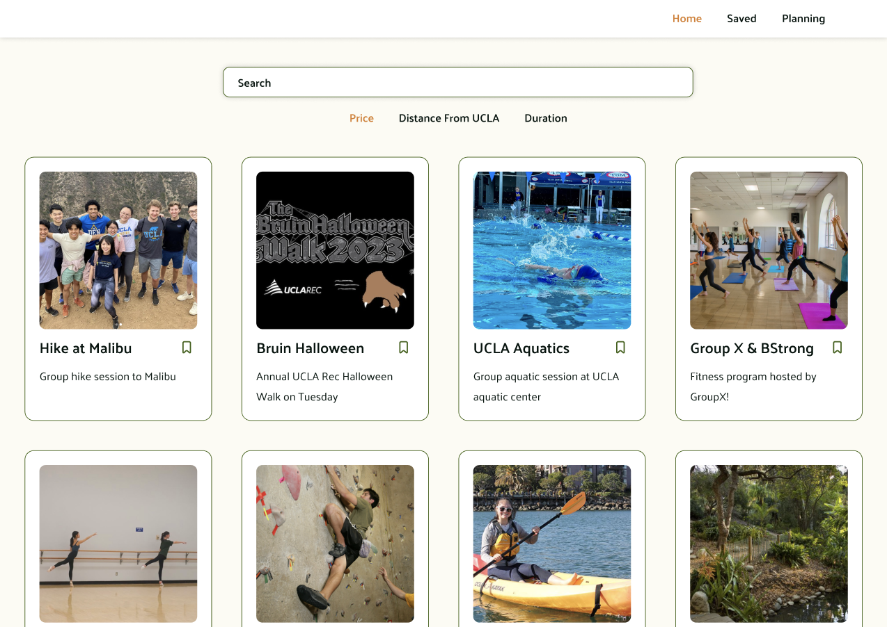
Homepage Comparison
Version A
Version B

Slide 25
Usability Test Tasks
Task 1: Explore Event Options
Task 2: Acquiring and Organizing
Task 3: Using the Planning Tool
Objective: Understand how users interact with the homepage to find events.
Browse homepage to identify top 3 event choices.
Use the filter feature to narrow down options.
Access saved list to find a specific event.
Objective: Assess how users gather detailed information about events.
Open and review the event page for specific details.
Note location, timing, and equipment requirements.
Explore transportation options, such as carpooling.
Objective: Evaluate user interaction with planning features.
Use the scheduling form to coordinate availability.
Create and share a carpooling form.
Customize and send a message to members, omitting unnecessary details.

Slide 26
Synthesized Findings (6)
Main Page
Planning Export
Activity Pages
Uncertainty on how filters were ordered
Otherwise easy to navigate around different available activities, and save bookmarks
Access to pages were universally intuitive
Volume and layout of information was generally agreed essential and effective
Should reconsider filter tags (add duration)
More descriptive caption
Planning was fine once they figured how to use it but was initially very confusing
Instructions were unclear or more often not read at all
This made using external tools very difficult
Difficulty in using external tools
User found it unclear of section usage (i.e. include/exclude) without verbal explanation
Users mention ease of access to booking and equipment information
Transportation tab well-received for its thoroughness (less cognitive load)
Bookmark Pages
Potentially burdensome without search bar
Hard to differentiate this page from home page

Slide 27
Implementing Changes
Home Page
Filtering
Revamped Planning Tools
Horizontal scroll bar/indicators. Categorical breaks in card lists. More vibrant descriptions, and refinement of card information composition.
Filtering results more clearly described, potentially with section titles/groups (i.e. “Free”, “$”, “$$”, etc. as new subsection titles of results). Undo option.
Mandatory onboarding for the full planning tool.
Display preview of completed message.
Consider restructuring or redefining sections for more intuitive usage.
Make forms/external links more communicative.
Clarifications
Reversible Actions
Landing page to introduce purpose and objective of application, and more thorough main page instructions.
Implement back button features, particularly from activity details webpage.

Slide 28
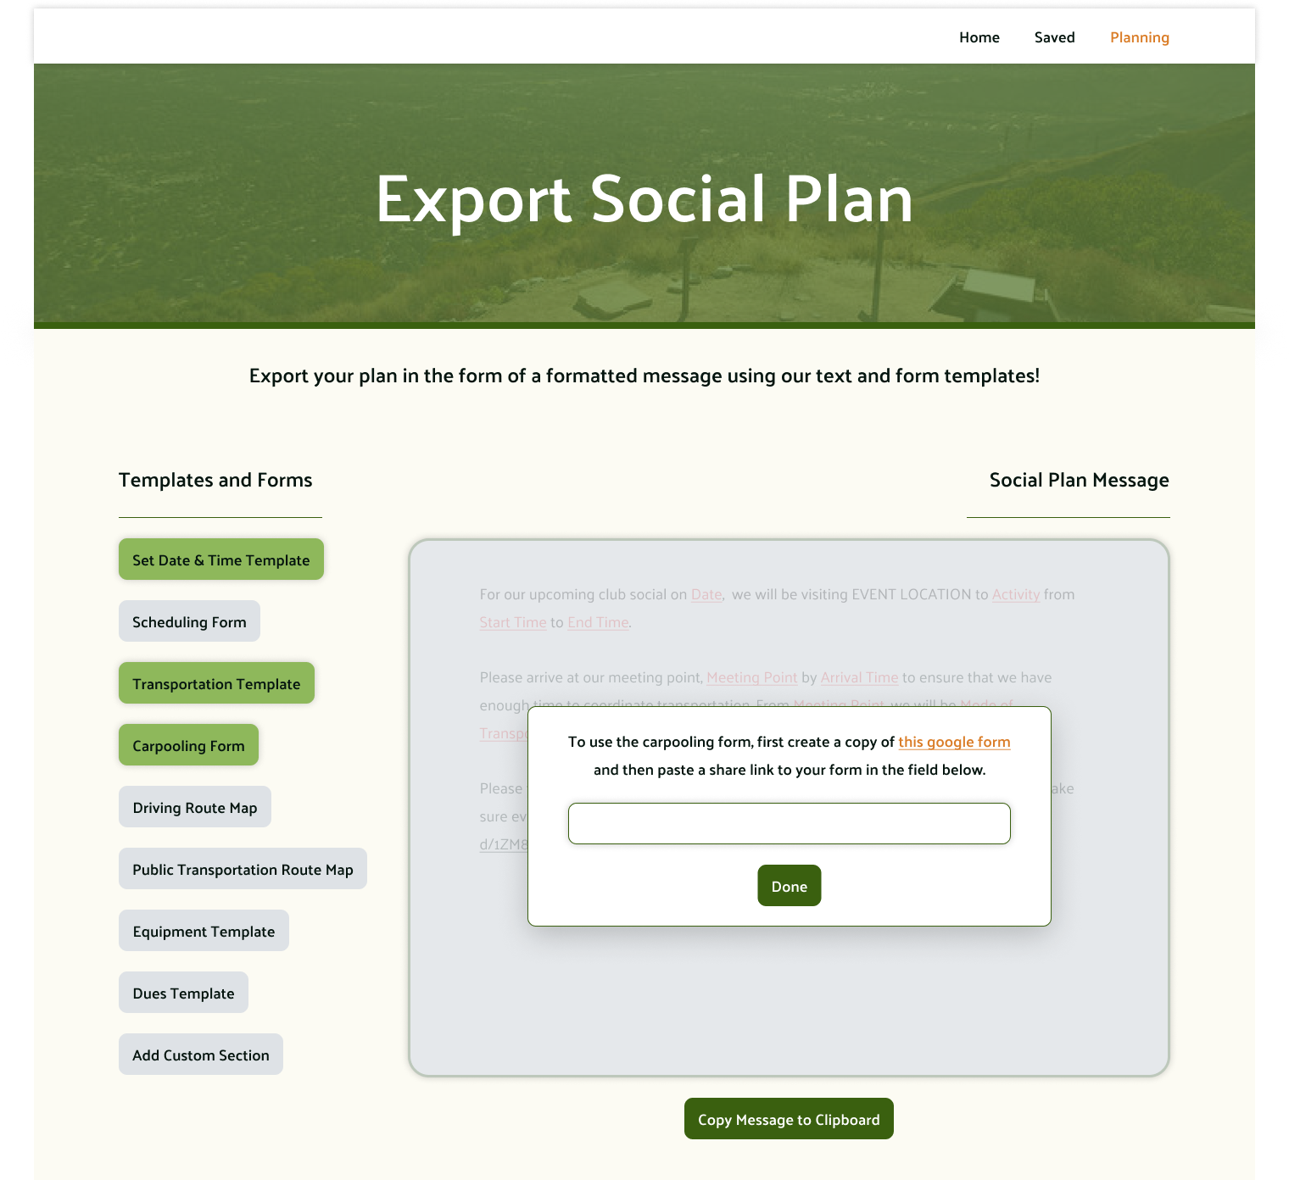
Revised Planning Tool
See Prototype
Button toggle provides intuitive way to add and remove sections
Unselected sections are no longer greyed out but removed completely
Lock-outs insure section instructions are read for external tools
More detailed instructions provide users with additional support for using external tools

